Slide 1
PnP Community Call – April 2015
aka.ms/OfficeDevPnP
aka.ms/OfficeDevPnPYammer
aka.ms/OfficeDevPnPGuidance
aka.ms/OfficeDevPnPVideos
PnP Core Team

Slide 2

Agenda
Demos, demos, demos
Monthly highlights
Contributions and other topics
Roadmap and next steps

Slide 3
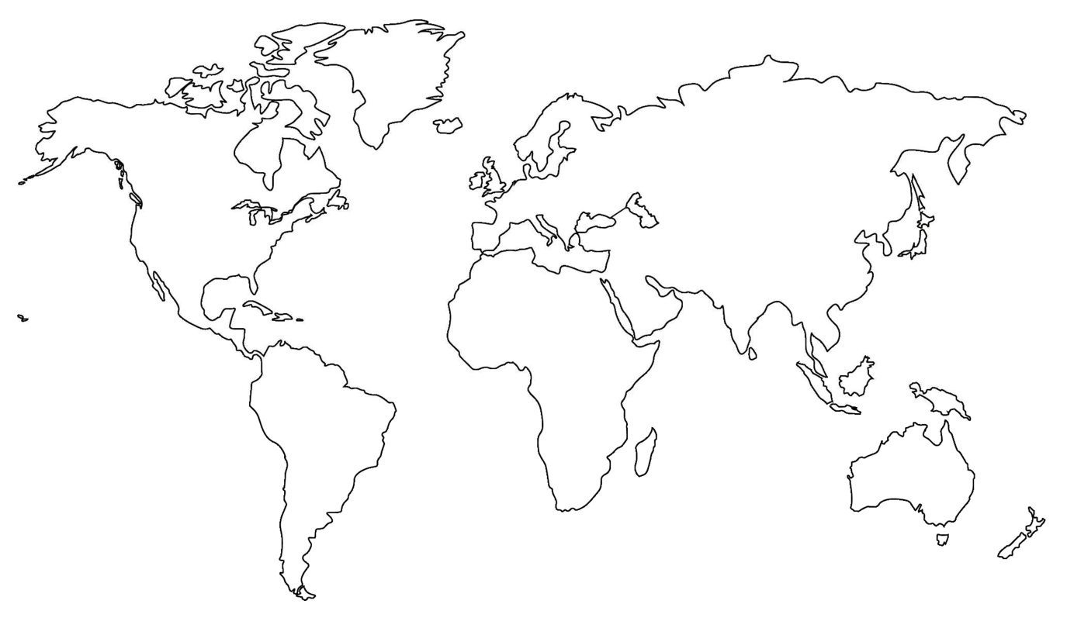
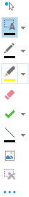
Where are you located?
Stamp Tool
Notes:
Length: 2 minutes for this slide
This slide is a quick demo/practice of the “Stamp” tool and how to use it during course interactions.
Have students Check where they live.
If it’s a small class, have students type their name where they live.
Reach out to the farthest away student

Slide 4

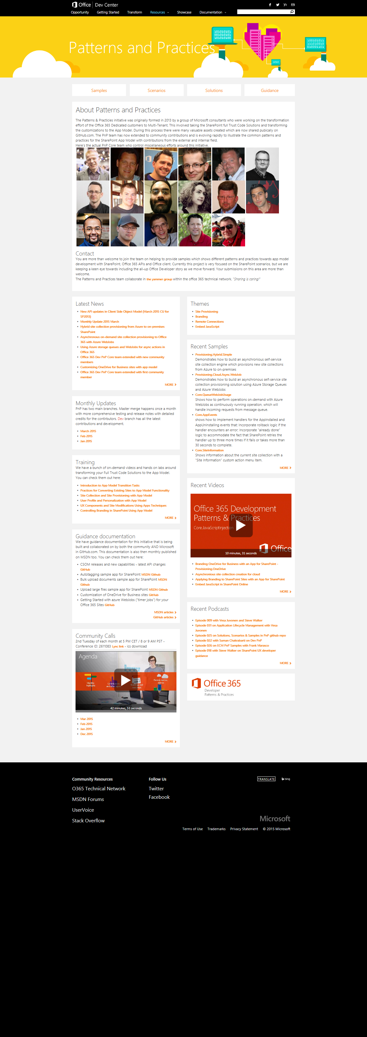
Developer
Patterns & Practices
aka.ms/OfficeDevPnP
aka.ms/OfficeDevPnPYammer
aka.ms/OfficeDevPnPMSDN
aka.ms/OfficeDevPnPVideos
aka.ms/OfficeDevPnPTraining

Slide 5
PnP model
Reusable samples and solutions
Core component
Community
Training
Presentations
PnP
JDP program
Guidance / MSDN
Seminar materials
Videos
Other assets

Slide 6
Statistics– Key numbers (previous month)
Forked 444 times (360, 282, 227, 190, 135)
479 merged pull requests (384, 329, 280, 236, 189)
122 closed issues (101, 73, 67, 58, 43)
More than 4100 (4100, 3776, 2566, 3050, 2160) unique visitors during last 2 weeks
Nuget package 5440 downloads (4711, 4450, 4030, 3800)
Yammer group has 2251 members (2013, 1739, 1525, 1419, 757)
aka.ms/OfficeDevPnPYammer
Facebook page has 175 likes (135, 121)
https://www.facebook.com/OfficeDevPnP

Slide 7
April Release
Site provisioning framework
Site provisioning schema v0.5
New samples and solutions
CDN Manager, MMS navigations, List Item change monitor
New MSDN linked articles
Note. Site provisioning framework is delayed, but still planned to get released during March

Slide 8

Thank you for your assistance!
Ashish Trivedi (Readify) @ashuetawah
David Mann (mannsoftware.com) - @MannD
Erwin van Hunen (Knowit AB) - @erwinvanhunen
Henrik Gustafsson (Happy Solutions AB) - @SharePointHenke
Hugh Wood (Rencore AB) - @HughAJWood
Marc Anderson (sympmarc.com) - @sympmarc
Paolo Pialorsi (PiaSys.com) - @PaoloPia
Radi Atanassov (OneBit Software) - @RadiAtanassov
Scot Hillier (shillier.com) - @ScotHillier
MS people – Antons Mislevics, Frank Marasco, Bert Jansen, Jeremy Thake, Vesa Juvonen, Brian Michely, Reeza Ali, Suman Chakrabarti, Ricky Kirkham, Steve Walker, Dan Budimir, Frank Chen, Kiki Shuxteau, Laura Graham, Ron Tielke, Sami Nieminen

Slide 9
New contributions
New sample Core.MMSNavigationSample demonstrates how to you can create MMS Based navigation for a site collection
New sample ECM.DocumentSets demonstrates how to use the new documentset CSOM API
New sample Core.ListItemChangeMonitor shows how to apply the ChangeQuery object to monitor list item changes
New scenario Provisioning.Framework.Console demonstrates the basic usage of the PnP provisioning engine
New solution Core.CDNManager. The CDN Manager is used to manage Content Delivery Network (CDN) references for JavaScript Libraries and Cascading Style Sheets (CSS) in SharePoint 2013 sites. Using the CDN Manager prevents multiple references to the same library and conflicts between libraries that may arise when such references are not managed globally.
Updated solution PowerShell.Commands with additional commands and various other updates.

Slide 10
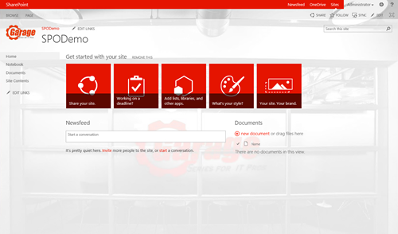
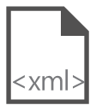
Site provisioning framework
C#
1
// Get template from existing site
template = ctx.Web.GetProvisioningTemplate();
Site A
XMLFileSystemTemplateProvider
2
// Save template using XML provider
XMLFileSystemTemplateProvider provider =
new XMLFileSystemTemplateProvider(@"c:\temp\", "");
string templateName = "template.xml";
provider.SaveAs(template, templateName);
// Load the saved model again
ProvisioningTemplate p2 =
provider.GetTemplate(templateName);
Connectors
XMLAzureStorageTemplateProvider
3
4
Site A
XMLSharePointTemplateProvider
// Apply template to existing site
ctxTarget.Web.ApplyProvisioningTemplate(template);

Slide 11
Site provisioning – schema design
New repository at https://github.com/OfficeDev/PnP-Provisioning-Schema
Objective is to standardize provisioning schema, so that re
Site provisioning framework will have adapter model for this standardized xml
Currently 95% there, but small adjsutments to be still applied either on the engine and schema side to fully align the efforts

Slide 12
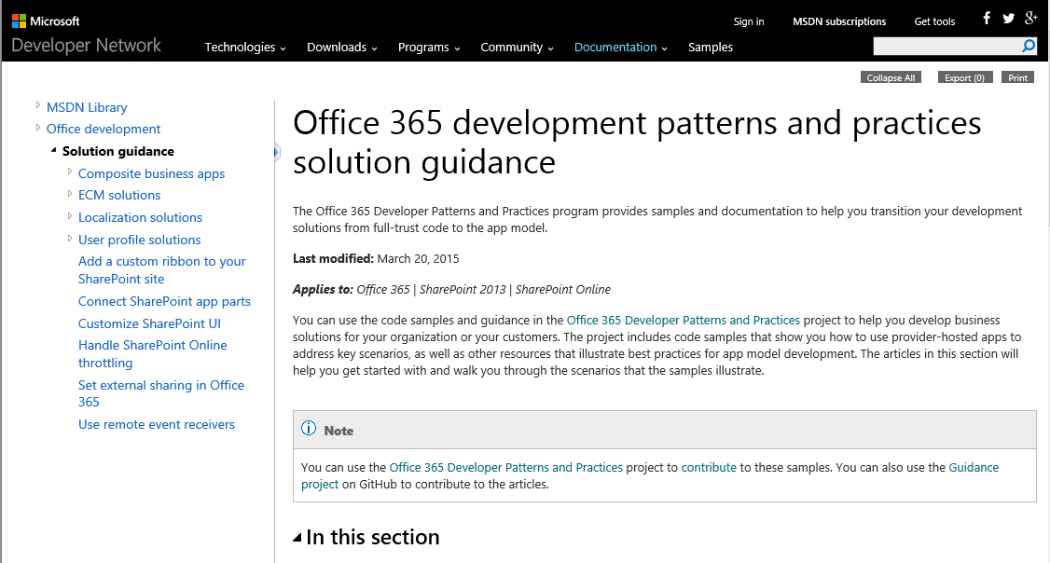
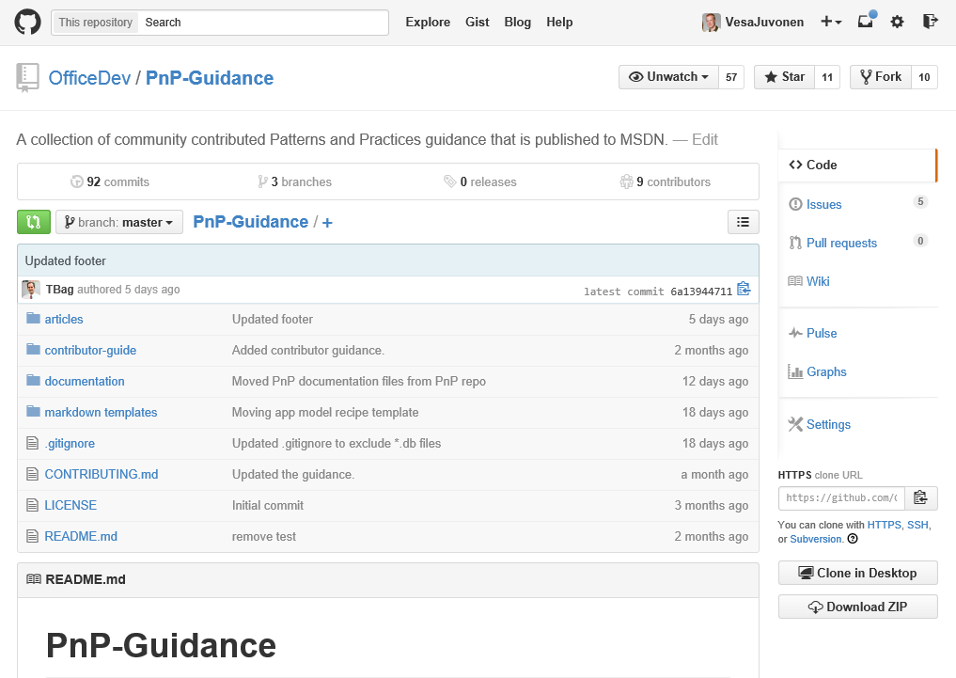
Updates in the Guidance repository
Constant updates based on MSDN articles
New recipes articles gradually being added
Articles as transformation recipes based on the PnP samples and guidance
Authored based on the PnP team input by Todd Baginski
Guidance – http://aka.ms/OfficeDevPnPGuidance
MSDN– http://aka.ms/OfficeDevPnPMSDN

Slide 13

Roadmap – May release plan
Provisioning engine v1.0
Core component v1.x
Continue evolving the Core component
Samples and solutions
Site provisioning solutions
Hybrid LOB system connectivity from cloud to on-premises
Contributions from the field
Articles
MSDN updates
On-premises App model setup – options and details on the needed configuration
Enterprise architect messaging
ALM
Recipes for transformation
JDP process to be released as reusable package for the field

Slide 14
Feedback…
Please keep the feedback coming in Yammer… we need your input for the prioritization.
Notes:
Priority on planned topics
More code samples
Add core component capabilities
Reusable presentation material
Documentation on patterns and practices for app model (ALM ec.)
More complex solutions
More Office Client apps
More JavaScript app
Length: 30 second for this slide
Instructor notes
The following slides will walk you though the Lync tools that we will use in this class.
You will use all of these tools later in the class
Stress that your students will be able to run much more engaging meetings if they use these tools in their own Lync Meetings.
Course Development Notes:

Slide 15

Demos, demos, demos!
Paolo – Site provisioning framework
How the core works?
Scot – CDN manager
What is it and how it works
(optional if time permits)
Brian – UI for upcoming full configurable provisioning demo

Slide 16
Transform your code Providing App Model Patterns for common Full Trust Code scenarios
130+ Visual Studio projects Common scenarios
Branding
Site provisioning
Remote event receivers
Large file support
Taxonomy driven navigation
And much more…
Contribute
This is open source project and open for contirbutions
Developer
Patterns & Practices
aka.ms/OfficeDevPnP

Slide 17

Questions?

Slide 18


© 2014 Microsoft Corporation. All rights reserved. Microsoft, Windows, and other product names are or may be registered trademarks and/or trademarks in the U.S. and/or other countries.
The information herein is for informational purposes only and represents the current view of Microsoft Corporation as of the date of this presentation. Because Microsoft must respond to changing market conditions, it should not be interpreted to be a commitment on the part of Microsoft, and Microsoft cannot guarantee the accuracy of any information provided after the date of this presentation. MICROSOFT MAKES NO WARRANTIES, EXPRESS, IMPLIED OR STATUTORY, AS TO THE INFORMATION IN THIS PRESENTATION.

